Slide 1

STOCK ANALYSER
Vasista Avinash Behara (13471A0567)
Siva Rama Krishna (13471A05B1)
Vamsi Krishna chigurupati (13471A0574)
Guide : G. Raphi, M.Tech
(Asst. Prof)

Slide 2
Index
Abstract
Existing System and its disadvantages
Need for a new System
Proposed System and its advantages
System Architecture(Modules)
System Requirements
Database Tables
UML Diagrams
Output Screens
Testing
Future Enhancements
Conclusion

Slide 3
Abstract
Stock Analyser is an online software application that fulfils the requirement of a typical Stock Analysis in various godowns.
It provides the interface to users in a graphical way to manage the daily transactions as well as historical data.
The aim of this application is to reduce the manual effort needed to manage transactions and historical data used in various godowns.
This application maintains the centralized database so that any changes done at a location reflects immediately.

Slide 4
Existing System
Paper-based systems originated as a system where details are entered and retrieved by hand.
Current system is a manual one in which users are maintaining ledgers, books etc. to store the information like suppliers details, inwards, deliveries and returns of items in all godowns, customer details as well as employee details.
Though there are few software based implementations, these are not centralized and not accessible to everyone.

Slide 5
Disadvantages(ES)
It is very difficult to maintain historical data.
Regular investments need to purchase stationary every year.
Daily transactions are to be entering into different books immediately to avoid conflicts which are very difficult.
Admin and user details can be easily obtained if incase these are written in documents.

Slide 6
Need for a new System
Easy to manage large amount of user and data store in electronic for long time.
Access Database from anywhere
The project is mainly aimed at providing employee friendly and effortless godown Stock management system.
No paper work
Display transaction results in tables and instantly display result for the administrator and user to analyse.
Prevent users from manipulating other employee details.

Slide 7
Proposed System
Proposed system is a software application that avoids more manual hours that need to spend in record keeping and generating reports.
This application keeps the data in a centralized way that is available to all the users simultaneously.
No specific training is required for the employees to use this application.
They can easily use the tool that decreases manual hours spending for normal things and hence increases the performance.

Slide 8
Advantages(PS)
Fast and easy way of managing godowns.
Admin can manage all the details.
Unique ID and Password gives more Secure Logins.
Stock Statements are generated fast.

Slide 9
System Architecture
The entire project is divided into modules
User information Module
Inwards Module
Delivery Module
Returns Module
Admin Module
Reports

Slide 10
User Information Module
This module maintains all the information which belongs to the employees who are working for the company.
It allows the administrator to add an employee record to the database very easily and it allows to view the list of employees in tabular format.
Employees can also add the information about customers, Suppliers, Items.
Admin can add and manage new godowns.

Slide 11
Inwards Module
This module maintains all the information related to manage inwards done in the godowns.
All the inwards are recorded to database and can be viewed as a report that displays all the inwards made by the company at each godown.
It allows the normal user to enter godown-wise inwards details whenever inwards done in any godown.
It doesn’t allow admin to enter the above details.

Slide 12
Delivery Module
This module deals with major and crucial part which includes deliveries of items whose purpose is for sale or service.
This module provides interface to add the deliveries details and can be viewed as a report that displays all the deliveries made by the company at each godown.
It allows the normal to enter whenever some delivery to has to done from any godown.

Slide 13
Returns Module
This module deals with another major and crucial part which includes returns of items whose purpose is of damage or order cancelled.
This module provides interface to add the returns details and can be viewed as a report that displays all the returns made by the customer at each godown.
It allows the normal user to enter return details whenever a return will takes place at any godown.
It also facilitates the user to view returns report in tabular format.

Slide 14
Admin Module
It also facilitates the user to view returns report in tabular format.
Admin can add user and delete user, supplier, customer, and review all the reports generated.
Users are divided into two categories.
Admin
Normal user - employee
Apart, there are suppliers and customers who cannot access anything.

Slide 15
Reports
Reports are generated daily or whenever new inwards, delivery or returns are made.
Godown report shows the details of godown and stock statement is generated and is shown after every physical transaction.
Details of user, customer, supplier, godown, and items are also displayed.

Slide 16
System Requirements
Software Requirements: (Minimum)
Web Browser - Google Chrome any version, Internet Explorer 7 or above.
OS - WIN 7, 8, 8.1, 10.
JAVA Version – JDK 1.7 or above.
Frontend – HTML (& HTML5), CSS (& CSS3),JS.
Backend - JAVA (JSP).
IDE – Eclipse (.mars2)
Server – Apache Tomcat
Database- MySQL

Slide 17
System Requirements
Hardware Components: (Minimum)
Processor – Pentium IV 2.0 or above.
Hard Disk – 50 GB
Memory – 512MB RAM

Slide 18
Database Tables :
Godown Table:
S.NO | ATTRIBUTE | DATA TYPE | CONSTRAINT | DESCRIPTION
1. | GodownID | Number(10) | Primary key | Godown identification
2. | Location | Varchar2(15) | Not Null | Godown location
3. | CapacityInQunitals | Number(5) | Not Null | Capacity in quintal
4. | GManager | Varchar2(20) | Not Null | Godown manager
5. | GSDate | Date | Not Null | Godown start date
5. | StockInQunitals | Number(5) | Not Null | Stock in quintals

Slide 19
Database Tables
Inwards Table :
S.NO | ATTRIBUTE | DATA TYPE | CONSTRAINT | DESCRIPTION
1. | GodownID | Number(10) | Foreign key | Godown id
2. | SID | Number(10) | Foreign key | ID of supplier
3. | ItemID | Number(10) | Foreign Key | Item ID
4. | DateOfSupply | Date | Not Null | Item supply date
5. | Quantity | Number(5) | Not Null | Quantity received
6. | ReceiptNo | Number(10) | Not Null | Receipt generated
7. | REmpID | Number(10) | Foreign Key | Employee who received
8. | Bill | Number(10) | Not Null | Bill generated
9. | CEmpID | Number(10) | Foreign Key | Employee who checked bill
10. | Invoice | Number(10) | Primary key | Inward supply details

Slide 20
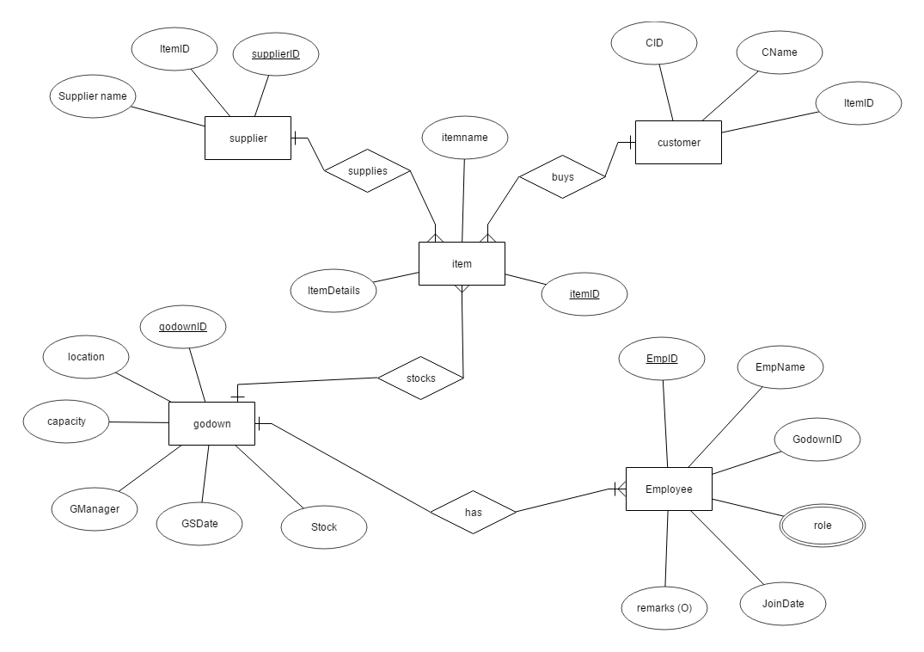
UML Diagrams
ER Diagram

Slide 21
UML Diagrams
Use Case Diagram(user)

Slide 22
UML Diagrams
Use Case Diagrams (Admin)

Slide 23
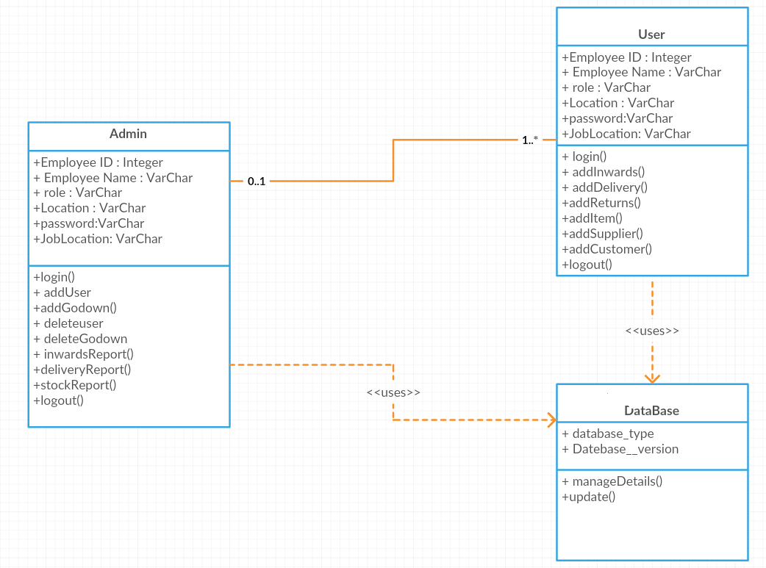
UML Diagrams
Class Diagram

Slide 24
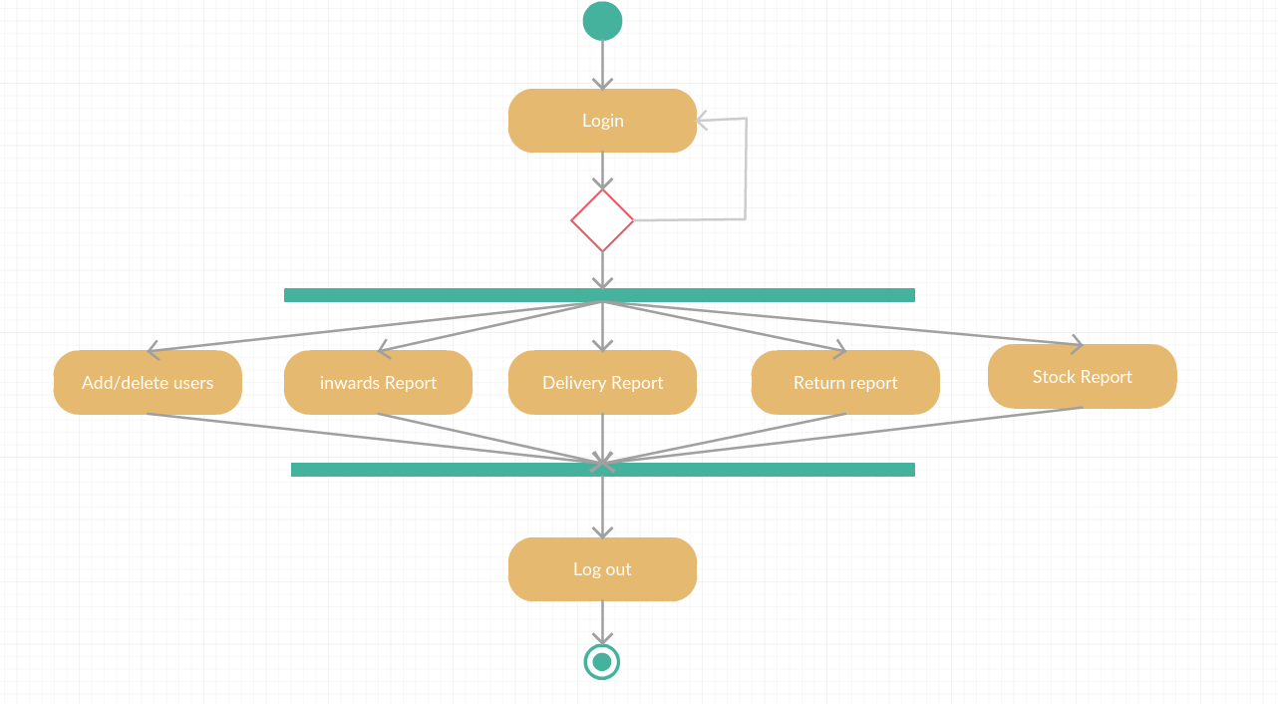
UML Diagrams
Activity Diagram(Admin)

Slide 25
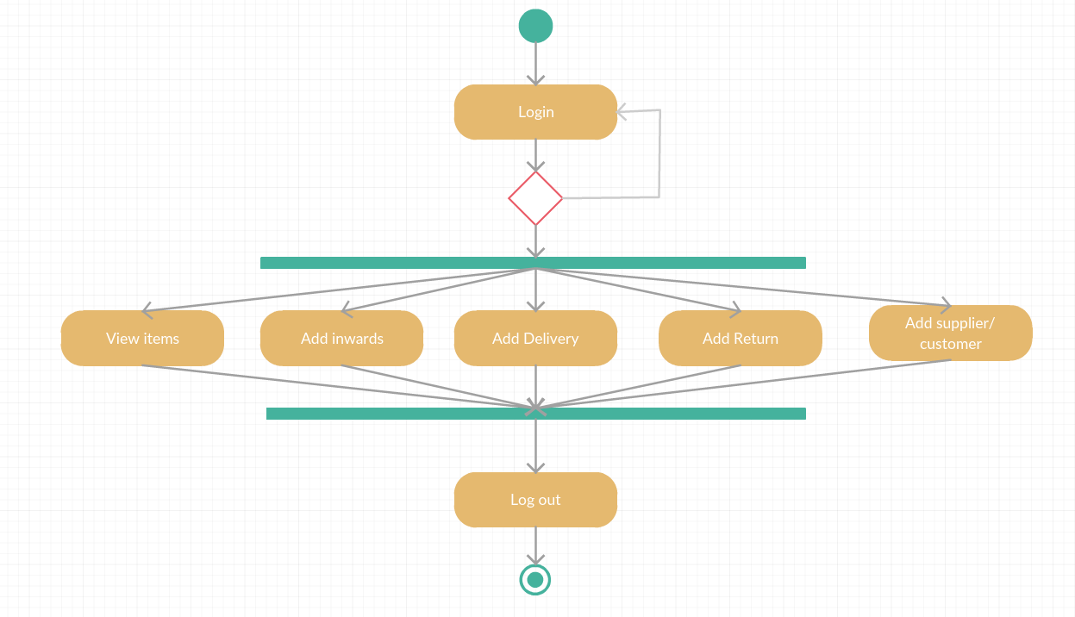
UML Diagrams
Activity Diagram(User)

Slide 26
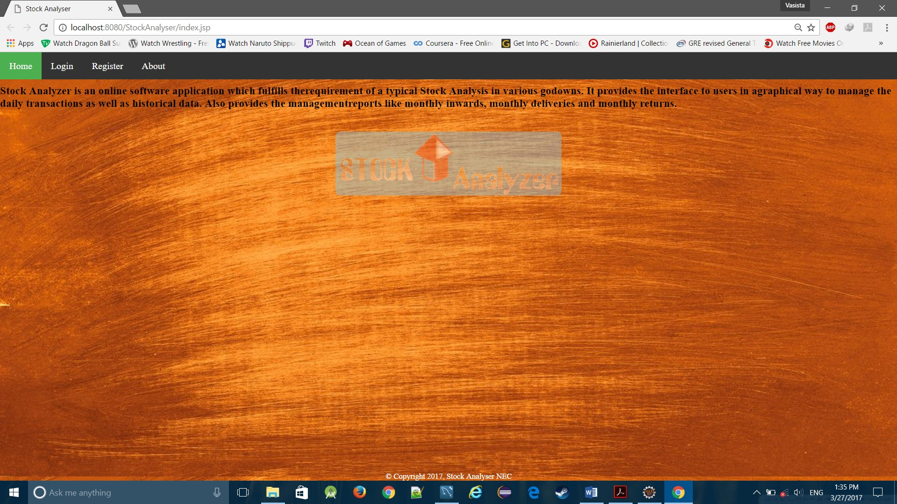
Output Screens
Index Page

Slide 27
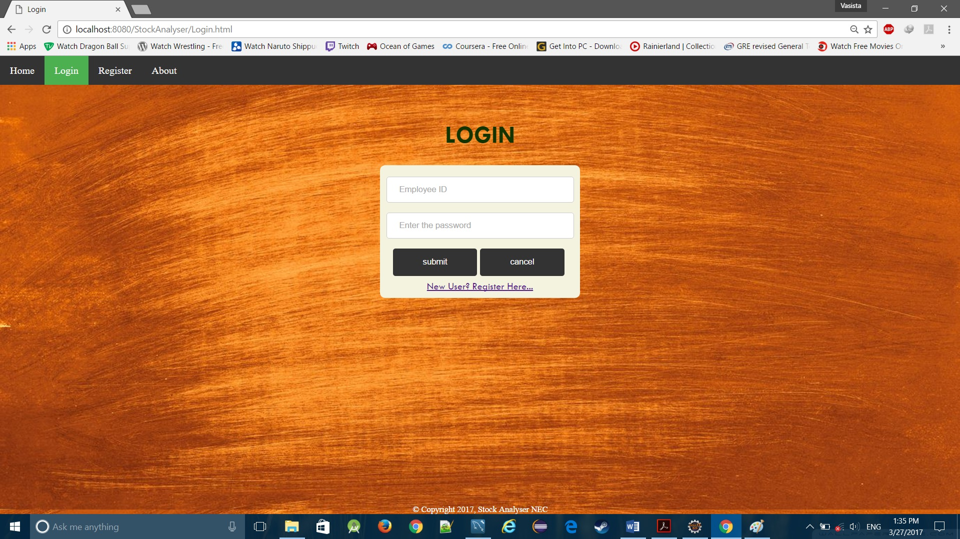
Output Screens
Login Screen – enter Employee id and password

Slide 28
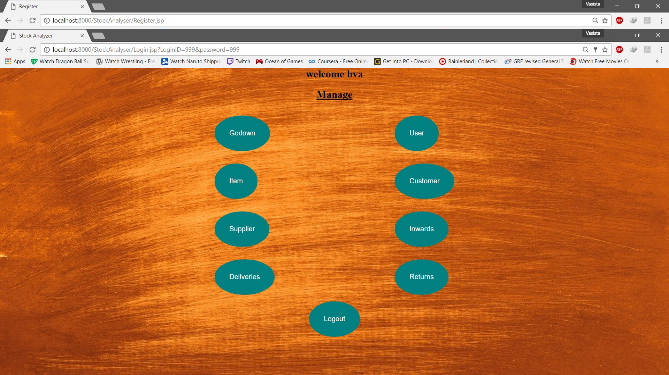
Output Screens
User Screen – all modules are displayed as buttons and users can interact with these modules

Slide 29
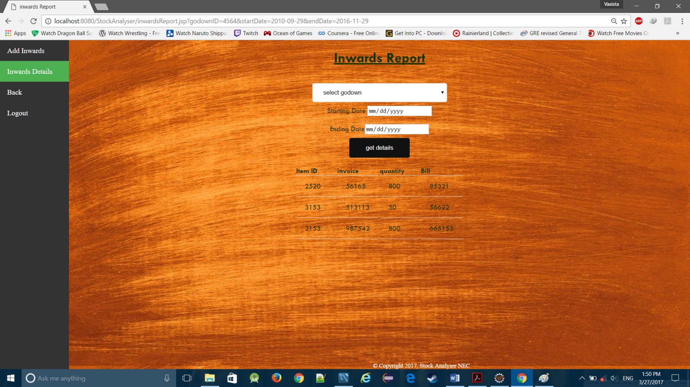
Output Screens
Inwards Report- inwards details are displayed as a table

Slide 30
Testing
S no. | Input | Expected Behavior | Actual Behavior | Output
Test case 1 | User login | Valid data | Invalid username /password | Failed
Test case 2 | User login | Valid data | valid username /password | Success
Test case 3 | Registration | Valid data | Invalid data | Failed
Test case 4 | Registration | Valid data | Valid data | Success
Test case 5 | User page | Open page | Page not open | Failed
Test case 6 | Inwards add | Valid data | Valid data | Success

Slide 31
Future Enhancements
Chances of hacking user or admins account. Security can be implemented by adding extra pattern matching and database securities.
Online database.

Slide 32
Conclusion
The efficiency of any system designed to suit an organization depends cooperation during the implementation stage and also flexibility of the system to adopt itself to the organization. “Stock Analyzer” has been developed to overcome the problems with traditional stock management in large scale.

Slide 33
THANK
YOU

